Slide 1

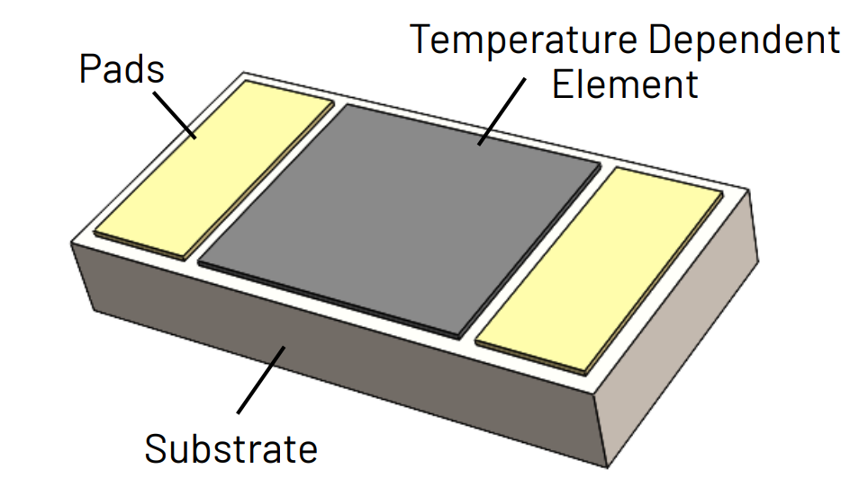
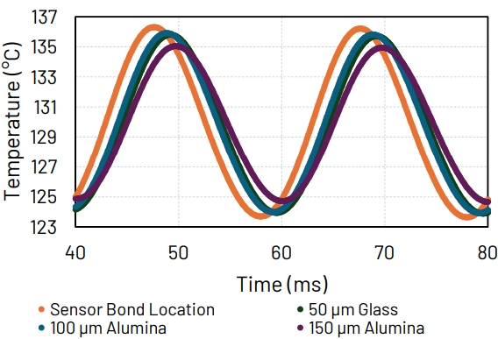
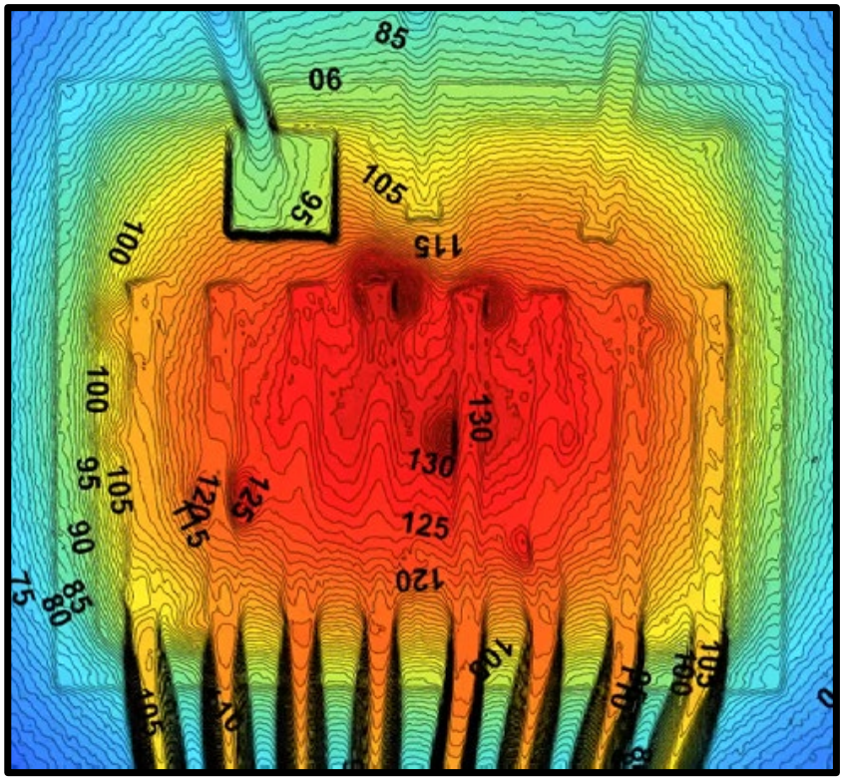
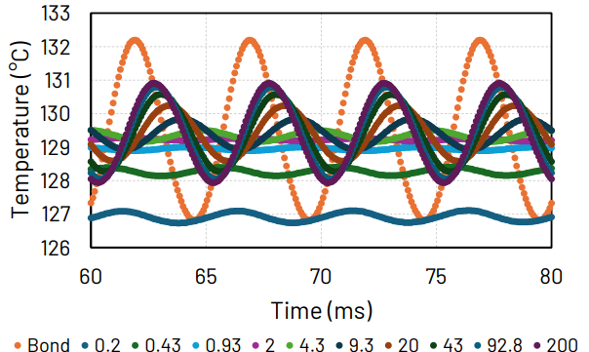
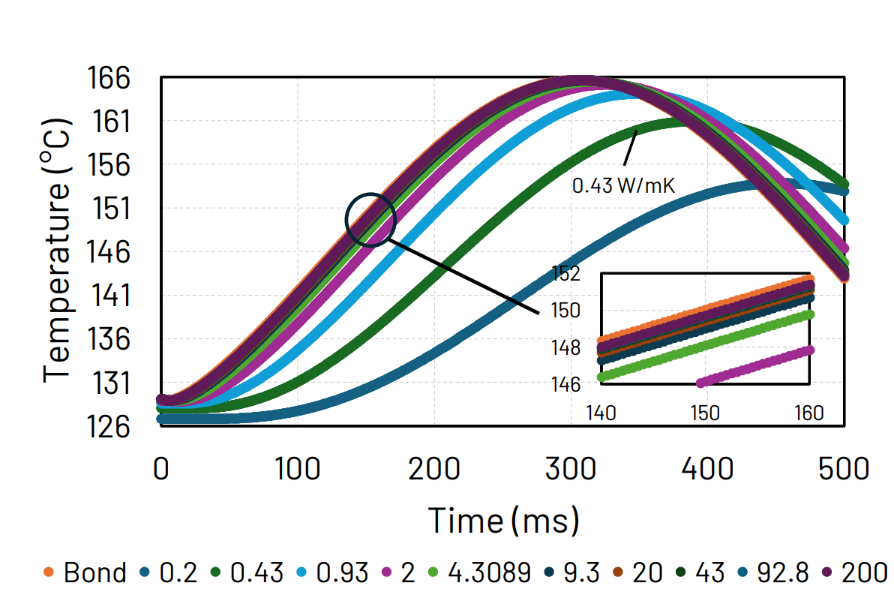
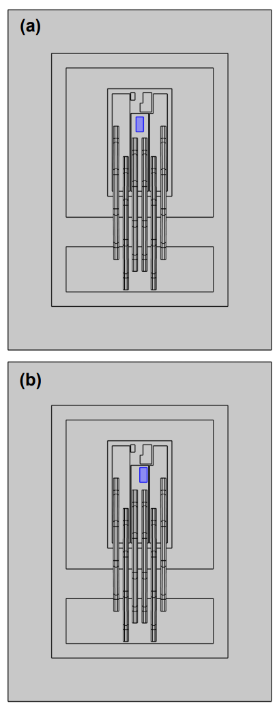
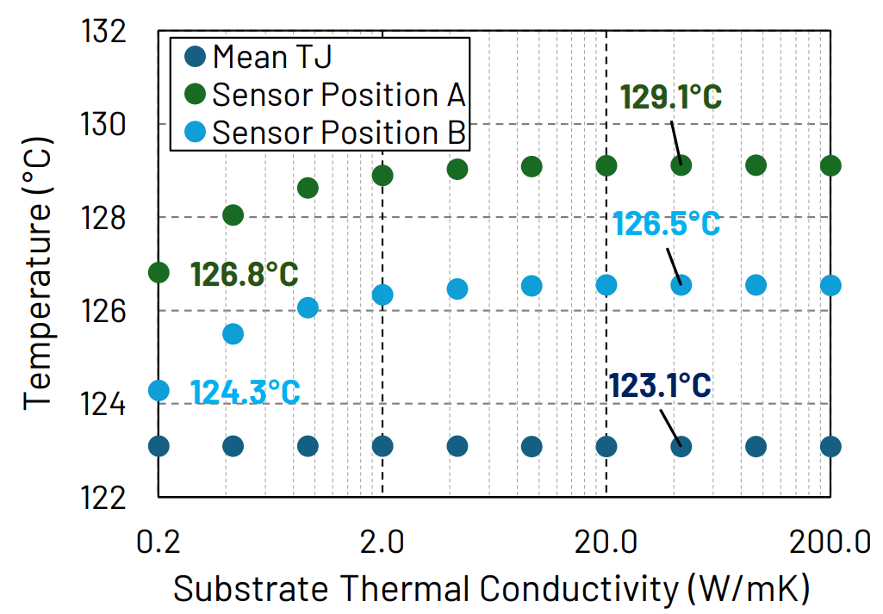
On-Chip Sensor Substrate Requirements for Accurate Junction Temperature Measurements
r
Nick Baker | Nathan Carlson | Andrew Lemmon| The University of Alabama
nbaker2@ua.edu, ncarlson@crimson.ua.edu, lemmon@eng.ua.edu
Motivation
Transient Results
The junction temperature of power semiconductors (Tj) is one of the most important parameters for module design, reliability, and failure analysis.
For this simulation, we used a sinusoidal heating current of 28A peak-to-peak overlaid on a 70A DC current. A 7.5 µm adhesive layer was also used with 3 W/mK.
Typical Tj sensor construction
At present, on-chip Tj sensors are limited by their substrate, which presents a layer of thermal resistance between the sensing element and the chip surface.
Previous results showing the large temperature gradient across the chip
Sensor temperature at 50 Hz using commonly available materials and thicknesses.
We analyze the relationship between the substrate thickness, thermal resistance, and sensor location and the accuracy of the temperature reading.
These results will be used to guide the choice of Tj sensors based on the intended application.
sensors based on the intended application.
Sensor temperature at 200Hz and 150 µm thickness, with several values of thermal conductivity.
Sensor temperature at 1 Hz and 150 µm thickness, with several values of thermal conductivity.
Steady-State Results
Finite-element simulation using constant heating current of 70.7A and heat transfer coefficients of 7500 W/(m^2K) at the baseplate and 20 W/(m^2K) across other surfaces.
At a grid frequency of 50-60Hz, the substrate conductivity and thickness make a large difference in the ability to track the temperature.
Largest impact in steady-state was the sensor position, with a difference of 2.5°C over a distance of only 270 µm.
High frequencies (200+ Hz) are difficult to track with any substrate material due to the resistance of the adhesive layer.
Thermal conductivity had minimal impact above 2 W/mK.
Conclusion
Locations of both sensor positions.
In steady-state, the largest source of inaccuracy is likely to be the sensor placement error.
In a transient condition, the sensor thickness appears to be the most important factor in the sensor’s bandwidth. This is evidenced by the fact that 50 µm of glass (k = 1.5 W/mK) provides less attenuation than 150 µm of alumina (k = 33 W/mK).
Commonly available substrates (150 µm alumina, 50 µm glass) were able to provide adequate tracking of a grid-frequency heating profile.
Future work should focus on the impact of the substrate heat capacity as well as the effect of the adhesive layer.
Sensor temperature vs substrate conductivity at 150 µm thickness.

